Slide 1


Bedding Bathing & Yonder Loyalty Program Customer Analysis and persona creation.
Conducted by Anastasia Vasileva
MBAN

Slide 2
Problem statement
Bedding Bathing & Yonder Company aims to optimize its loyalty program by finding insights and by creating personas to better understand their customers' needs.
For these reasons, Exploratory Data Analysis was conducted to identify key customer characteristics. The goal of this analysis is to create a “top customer” persona and provide actionable insights that will enable BBY to improve customer engagement, retention, and satisfaction.

Slide 3
Data limitations and strategy
The data provided contained data gaps, which interfered with the analysis. Some columns contained 99% missing data.
-Data was not evenly distributed and results on the final data frame were not significantly important.
- To gather insights, it was decided to filter customers by their average expenditure with BBY and their store visits frequency. Remained customers are considered to be “top customers” and were used for analysis.

Slide 4
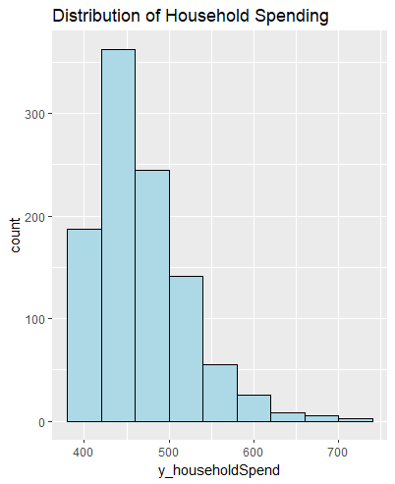
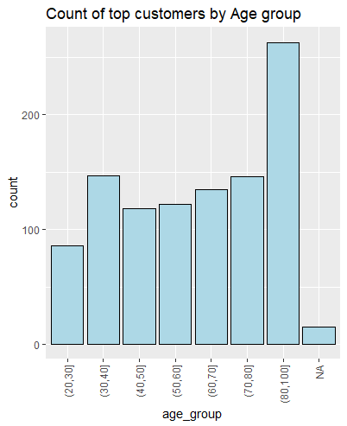
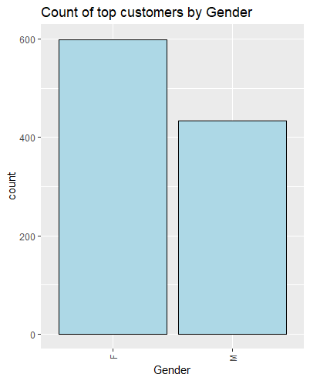
Patterns of the “Top customer”
Most of the top customers spend around 450$
25% of our top customers are in the age range of 80-100.
Almost 60% of our top customers are Female.

Slide 5
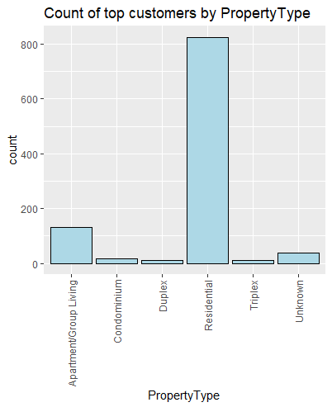
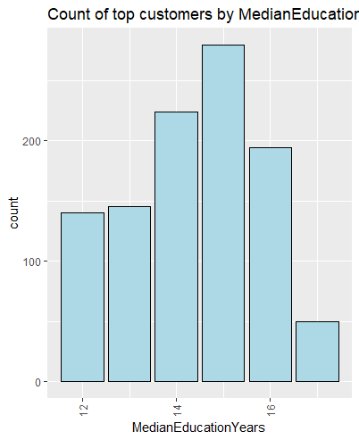
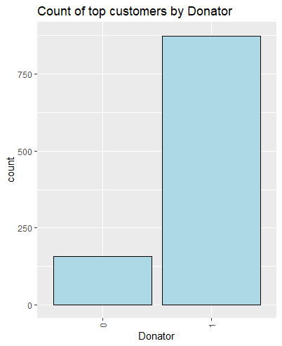
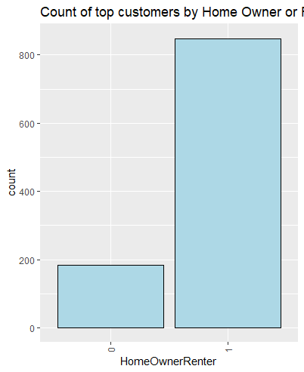
80% of top customers live in "Residential" property type.
Patterns of the “Top customer”
Almost 30% of top customers have 15 years of education
85% of our top customers donate.
82% of our top customers have their own homes and do not rent.

Slide 6
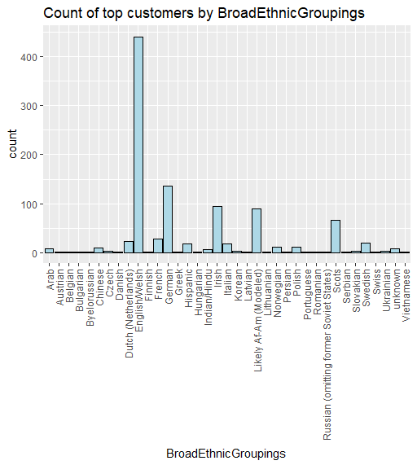
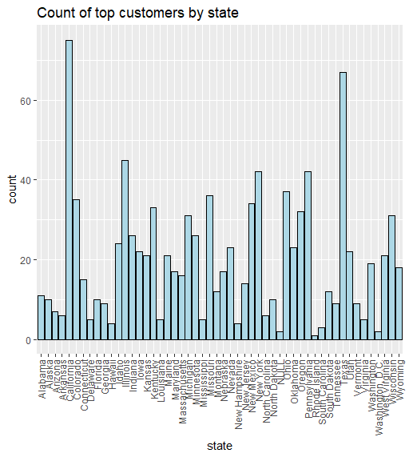
High majority of our customers are from California and Texas.
42% of our top customers are English/Welsh.

Slide 7
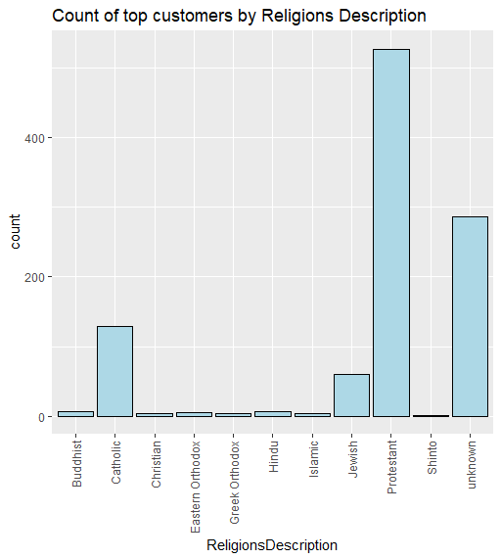
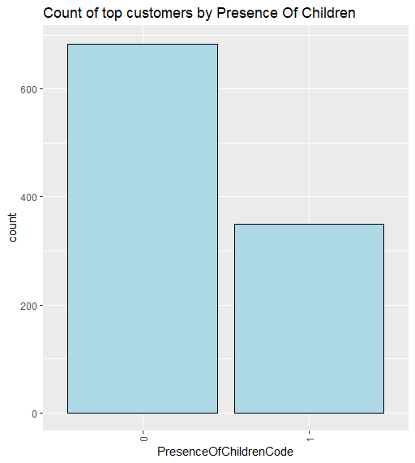
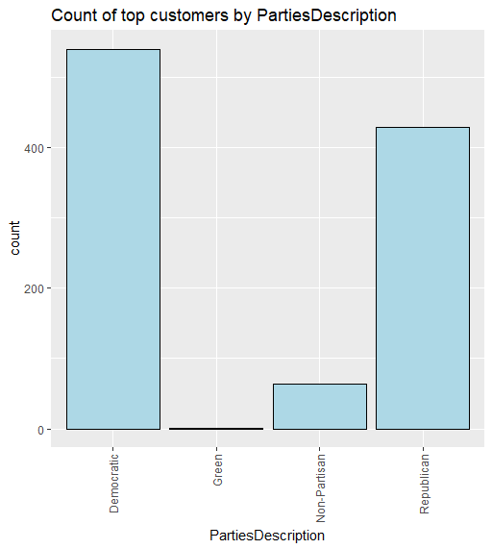
66% of our top customers do not have children.
Patterns of the “Top customer”
More than half of our top customers are Protestants.
More than half of our top customers are Democratic, and 40% are Republican.
Almost 50% of top customers have an average Net Worth in the range of 160.000-176.000$

Slide 8
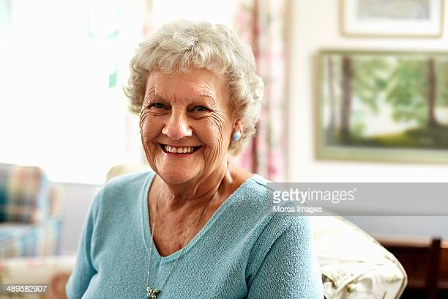
Persona
After the “top customers” analysis was conducted the following persona was identified:
Meet Clara, an 85-year-old English woman living in California, who is a retired schoolteacher with a net worth of $175,000. Clara lives in a residential property and has been a loyal BBY customer for several years. She is a Democrat and has no children. Clara is a regular donor to charity and considers herself to be a Protestant.
Source: https://www.gettyimages.fr/photos/old-woman

Slide 9

Four interesting insights about Clara as a persona:
Clara is in the age range of 80-100 and has a net worth of $ 160.000-176.000. This suggests that there is a significant segment of senior clients who are loyal to BBY and have the resources to purchase the products offered by BBY. This group tends to have more disposable income and may spend more on home decor, bedding, and bath items.
Clara is a Democrat, and Democrats make up a large share of BBY's top customers, suggesting that political affiliation may be a factor in purchasing behavior. This could be the basis for targeted marketing efforts that target specific political leanings.
Clara regularly donates to charity, and 85% of BBY's top customers donate. This suggests that there is a significant segment of clients who value philanthropy and are more likely to shop at a store that aligns with their values.
30% of BBY's top customers have 15 years of education or more. This suggests that there are a significant segment of highly educated customers who value high quality and service of BBY.

Slide 10
Actionable insights
The fact that a high majority of top customers are from California and Texas could indicate that BBY has a larger customer base in these states. The company may try to increase its presence in other states, investing more money in marketing and advertisement.
The high percentage of top customers who are female suggests that BBY's marketing efforts may be more effective at reaching women. The company may try to improve its marketing by targeting more males to increase its customer base.
The company can consider personalizing more mail and email coupons, tailored to identified top customer persona's shopping preferences.
BBY can create targeted promotions and discounts for the identified persona.

